Slide 1
Meeting 27.08

Slide 2
Ergodic loss terms
 | Ergodic error (Fourrier)
CFM | 4,651
λ = 2 | 4,254
λ = 25 | 3,158
λ = 100 | 2,460
λ = 200 | 2,245
λ = 400 | 2,140
SVGD-Solver (“Groundtruth” from db) | 2,709

Slide 3
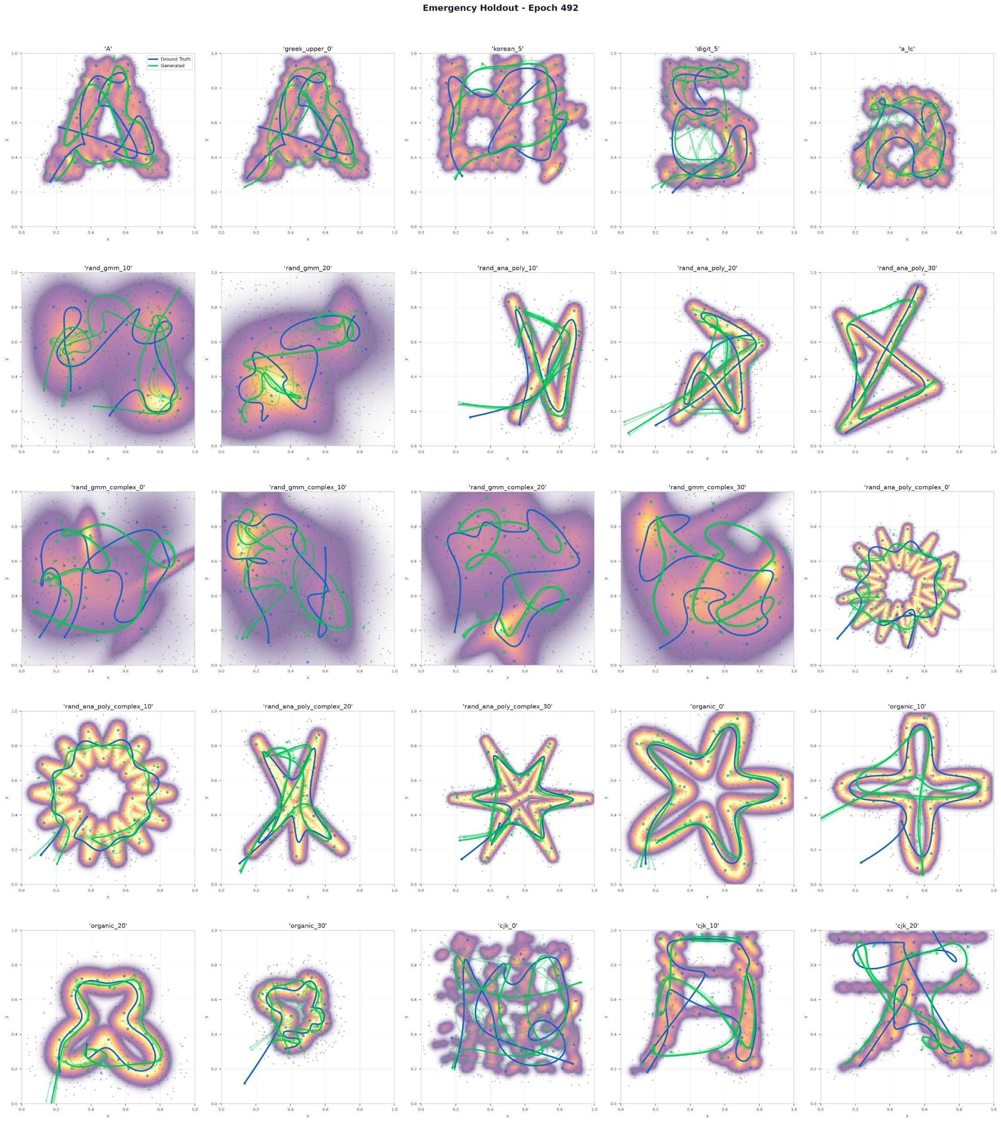

Ergodic loss terms
λ = 2 | λ = 400

Slide 4
Belief as Target Density
Combine two target distributions each represented as GP:
μ(x) := known target distribution
σ(x) := uncertainty distribution
Φ(x) = μ(x) + κ · σ(x)
Different planning approaches:
Ergodic planning on Φ(x)
First step exploration of σ(x), update μ(x) than exploitation of μ(x)
Or compromiss:
Ergodic planning on Φ(x)
Execute part of path, update Φ(x) replan and continue
➔ Problem: no startpiontconditioning
Trained on new databank with random startpoints and included starpointconditioning via FILM architecture (same as time conditioning)

Slide 5
Belief as Target Density
Test setup:
Exploration kernel length of 0,08 around exploration path
Different starts:
60 Randomly measured points on map
Half-half known/unknown
Different quadrants known/unknown
Center hole is unknown

Slide 6
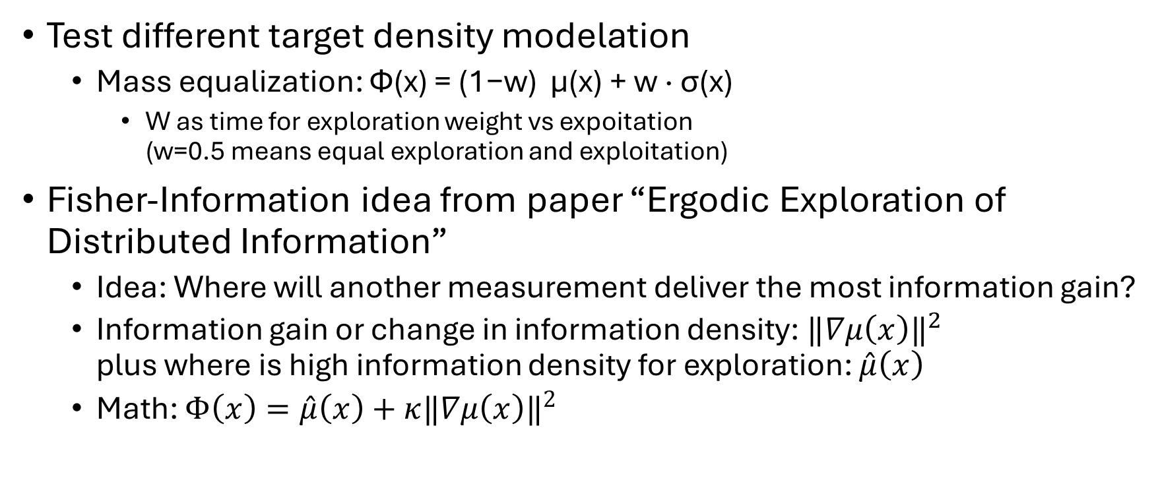
Belief as Target Density
Test different target density modelation
Mass equalization: Φ(x) = (1−w) μ(x) + w · σ(x)
W as time for exploration weight vs expoitation (w=0.5 means equal exploration and exploitation)
Fisher-Information idea from paper “Ergodic Exploration of Distributed Information”
Idea: Where will another measurement deliver the most information gain?
Information gain or change in information density: $‖∇μ\left(x\right)‖​^{2}$ plus where is high information density for exploration: $\overset{ˆ}{μ}\left(x\right)$
Math: $Φ\left(x\right)=\overset{ˆ}{μ}\left(x\right)+κ‖∇μ\left(x\right)‖​^{2}$

Slide 7
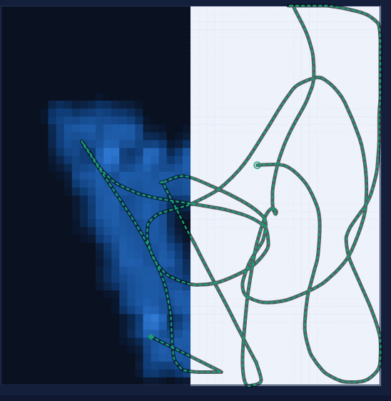
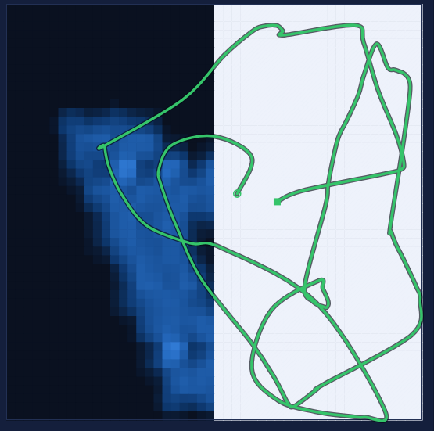
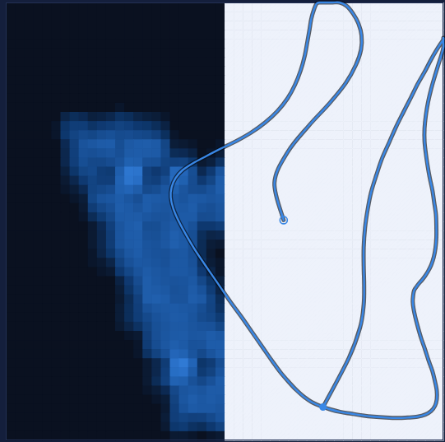
Ergodic planning on UCB
One time planning | Two stage planning | Constant replanning

Slide 8
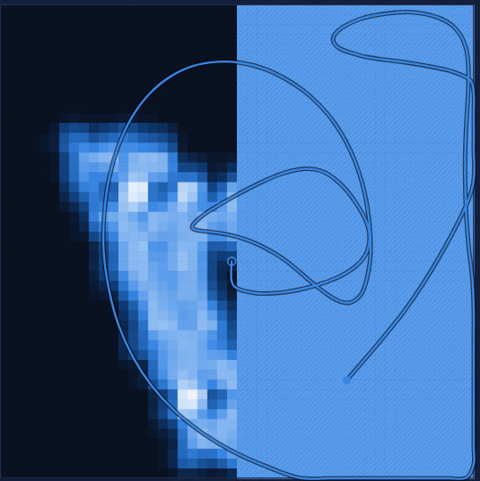
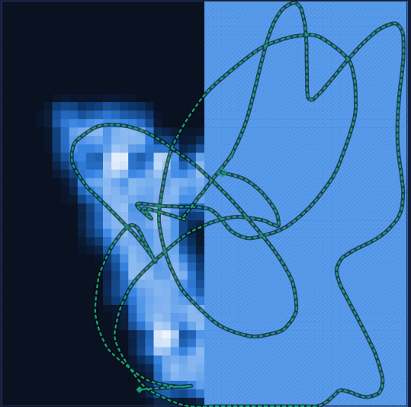
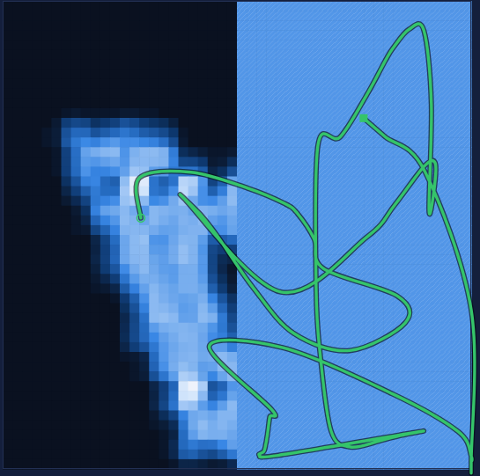
Ergodic planning on UCB with Mass equalization
One time planning | Two stage planning | Constant replanning

Slide 9
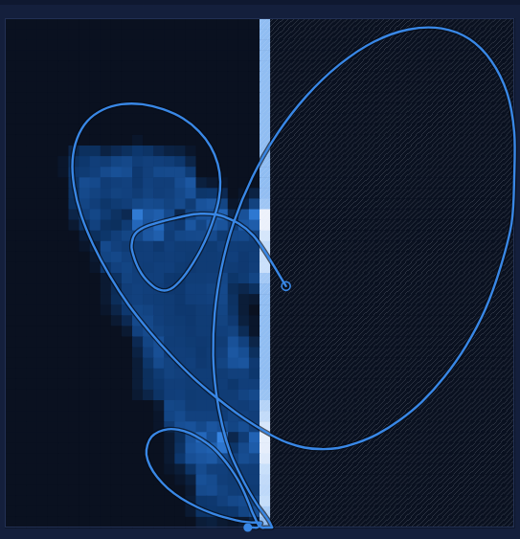
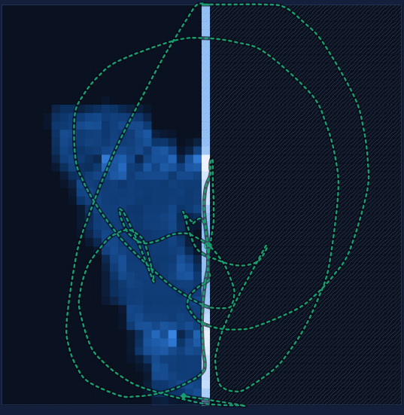
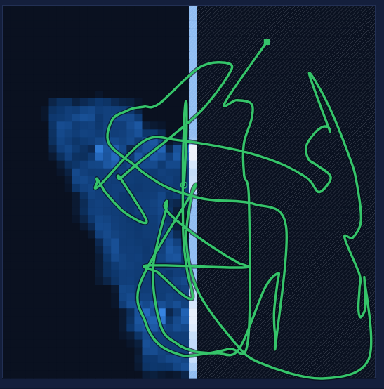
Ergodic planning on Fisher-Information
One time planning | Two stage planning | Constant replanning

Slide 10
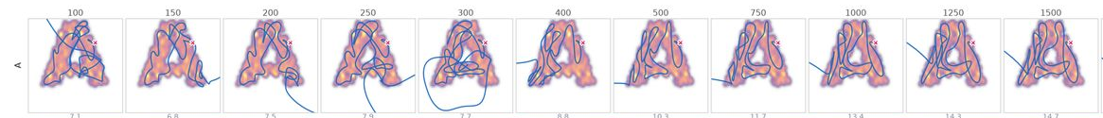
Problem: length
The longer the trajectory is, the better the result, hard to define stop or limit length
especially for the constant replanning
➔ idea if it is possible to condition on length, each replanning step can reduce length
Databank with different iteration numbers for different lengths, no successfull inference yet

Slide 11
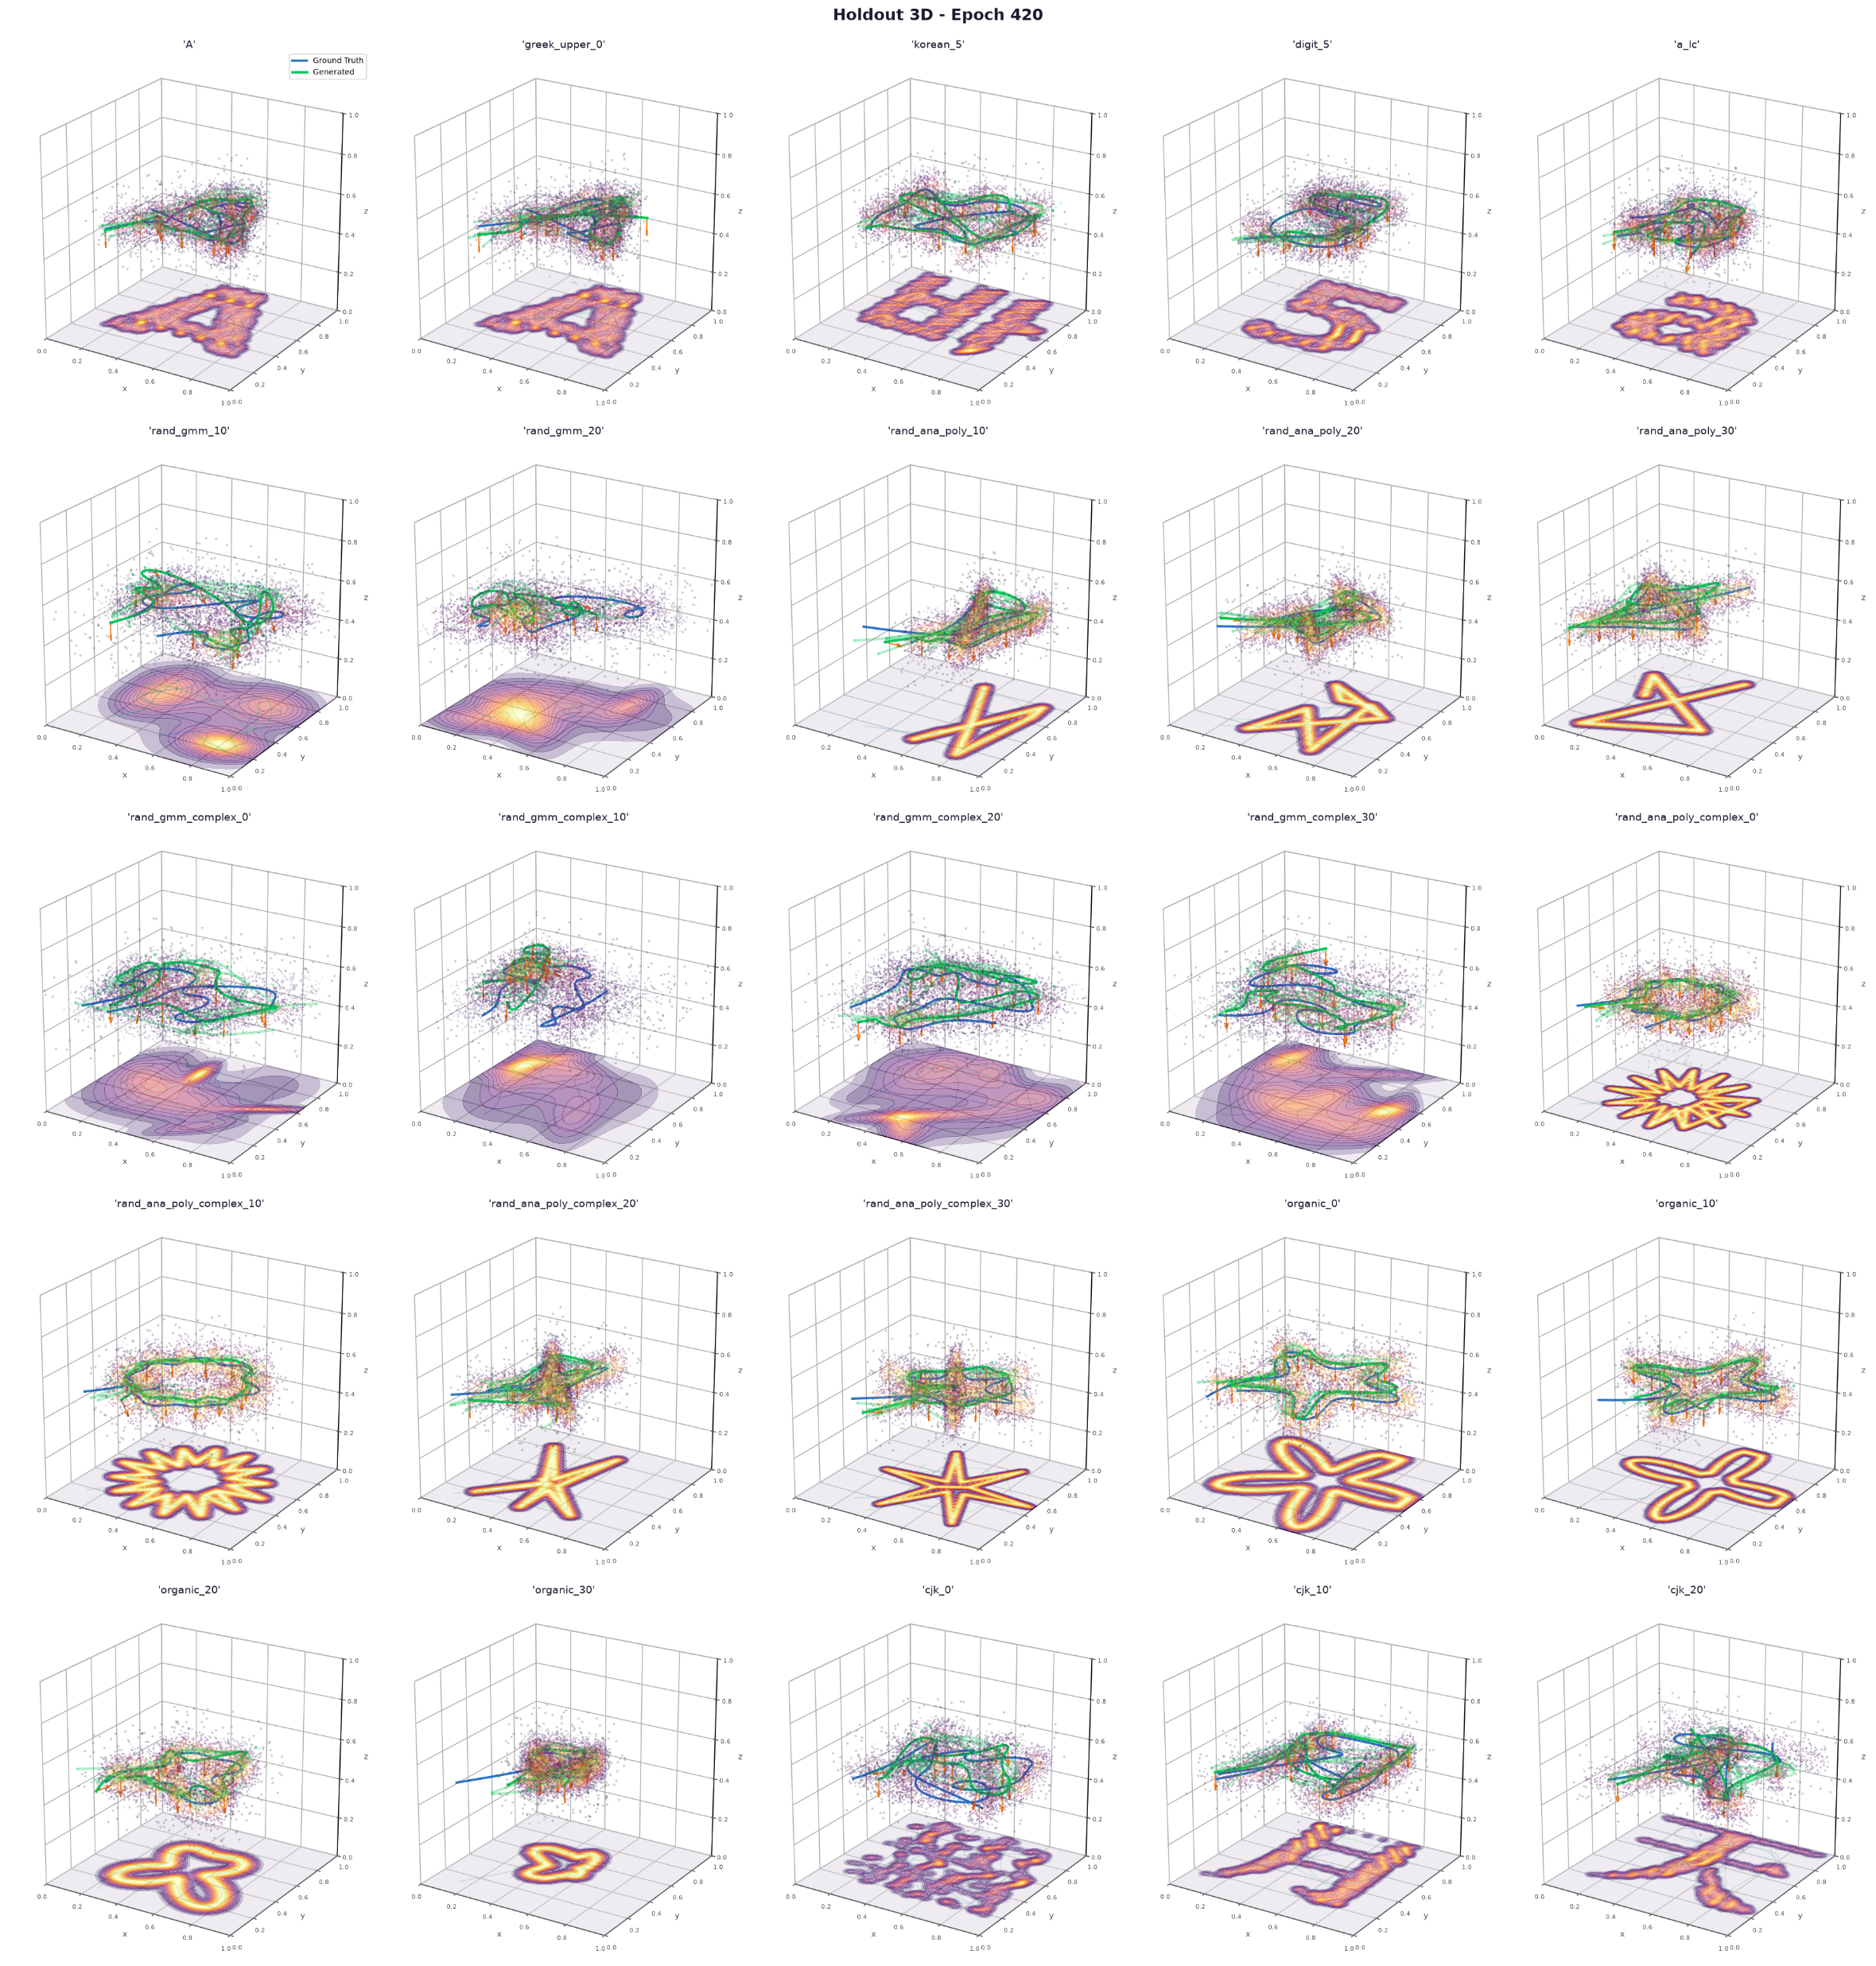
3D transfer
First step:
Add third dimension to 2D database (just as 0)
Train same architecture to generate B-Spline cps with third dimension
Test generalizability to different plane orientations/shapes

Slide 12
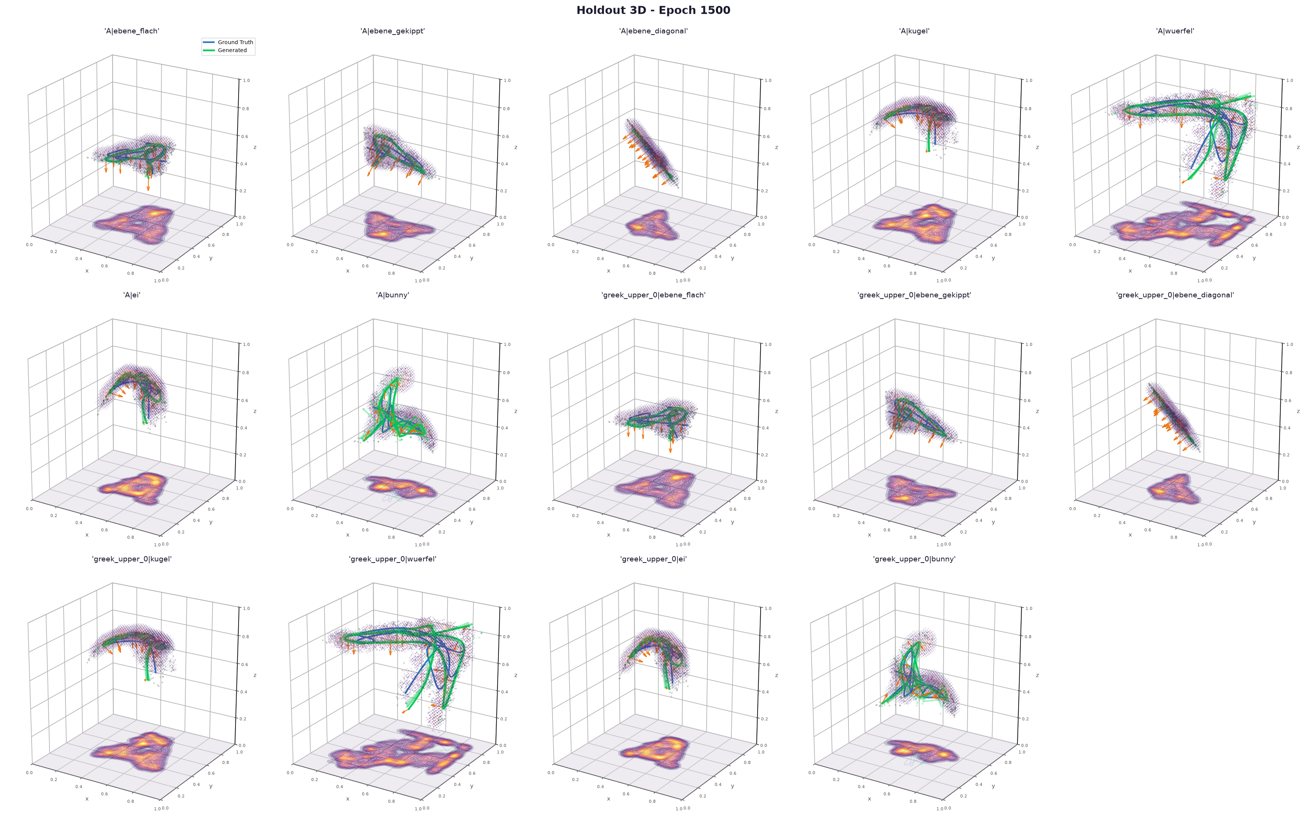
3D transfer
second step:
Change database:
Project shapes and trajectories on different surfaces
Train on new database

Slide 13
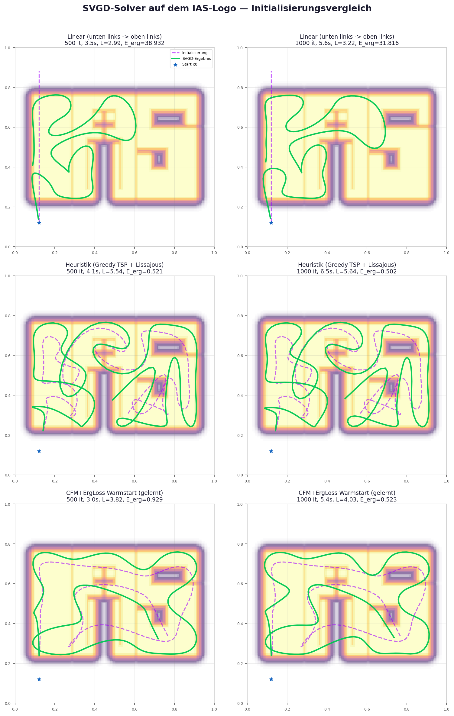
First tests of comparison of initializations
 | Ergodicity before svgd (1000 iterations) | Ergodicity after svgd (1000 iterations)
heuristic | 1,628 | 0,502
cfm | 1,015 | 0,523

Slide 14
Plan for next week
Expand 3D database for more 3D shapes to learn generalization
Finetune existing models on these extension
I´ntroduce more constraint…
Make a larger analysis and comparison of different initializations (IAS logo)
Try mujoco simulation
Improve uncertainty exploration/exploitation
Make use of pathlength conditioning to limit exploration ➔ introduce a budget
Fair comparisons with similar pathlengths
Find and analyze a metric

